Slide 1

Why MongoDB ?
By
Md Joynal Abedin
Shakil Ahmed

Slide 2
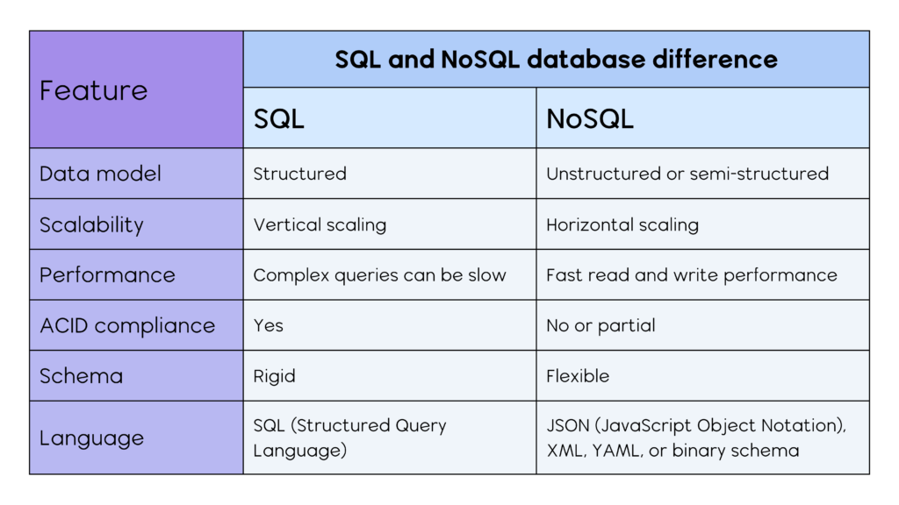

Slide 3
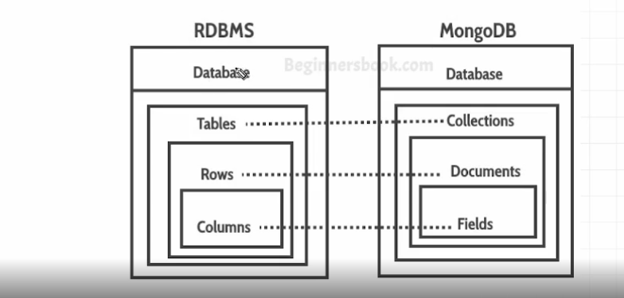

Slide 4

Why MongoDB is the Perfect Fit for NearNook
Discover how MongoDB’s flexibility, scalability, and performance make it the ultimate database choice for NearNook’s innovative e-commerce platform. From geospatial magic to real-time analytics, here’s why MongoDB is the backbone of my success! 🚀

Slide 5
Flexible Schema: Adapt to Change
Dynamic Data
No Headaches
Agile Development
MongoDB’s document-based model effortlessly adapts to ever-changing product catalogs and user data.
Say goodbye to rigid tables and schema headaches! Enjoy the freedom to evolve user data structure.
Iterate quickly and efficiently with a database that keeps pace with your development cycle.

Slide 6




Scale Seamlessly: Handle Anything
Start with a few users and scale to millions.
Horizontal scaling ensures NearNook stays fast and reliable.
Handle peak shopping sprees with ease and confidence.

Slide 7




Blazing-Fast Performance
Product Searches
Deliver lightning-fast product searches.
Smooth Checkouts
Enable smooth and efficient checkouts for customers.
Real-Time Tracking
Provide real-time order tracking with optimized operations.

Slide 8

Geospatial
Queries
Find Nearby Shops
Find Shortest Path
MongoDB’s built-in geospatial queries make location-based browsing effortless.
Include delivery charge calculation based on distance and estimated delivery time.
Filter Product
Display products available in a specific region.

Slide 9



Real-Time Insights: Smarter Decisions
1
Improve Sales
2
Track Inventory
3
Empower Merchants
Empower merchants with real-time sales analytics and inventory tracking using MongoDB’s powerful aggregation framework.

Slide 10



Future-Proof Development
2
React
1
NodeJS
Microservices
3
Built for modern tech stacks, MongoDB integrates seamlessly with Node.js, React, and microservices, accelerating development.

Slide 11

Always On, Always Reliable
1
Replica Sets
2
Automatic Failover
Ensure data redundancy and availability.
Maintain uptime with automatic failover.
3
Continuous Operation
Keep NearNook running, no matter what.

Slide 12
Thank You

